Slide 1
Connecting Standard Li-Ion Batteries in Series to Form a High Voltage Array
Ori Kost
Michael Baab
Epsilor

Slide 2
Contents
Why is a high voltage DC electrical bus inevitable in heavy combat vehicles?
Why can’t we connect Li-Ion batteries in series like AGM batteries?
Hazards in a serial connection of Li-Ion batteries (battery string).
Principle HV Li-Ion battery design.

Slide 3
I.
Why is a High Voltage (HV) DC
Bus Inevitable in Heavy Combat Vehicles?
The MIL-STD-1275 28 VDC electrical bus with 4/0 AWG or 250 kcmil cables is limited to ~10 kW of continuous power.
The HVAC system on board the vehicle consumes ~5 kW.
Only ~5 kW are available for all other systems. Not enough power!

Slide 4
II.
Why Can’t We Connect Li-Ion
Batteries (LIB) in Series Like AGM Batteries?
LIBs have an internal safety switch, AGMs do not.
When a voltage loop is cut open, the entire voltage drops on the open terminals.
LIBs’ switches are designed to withstand 2 or 3 the LIBs maximum voltage.
LIBs’ switches are at risk!

!

Slide 5
III.
Hazards in a Serial Connection of
LIBs (Battery String).
LIB hazards.
Serial connection hazards.
High voltage hazards.

Slide 6
III-1.
LIB Hazards
A LIB’s safe operating area (SOA) defines ranges of temperatures, voltages, and currents which are safe for the LIB to operate in.
Exceeding those ranges may result in a Thermal-Runaway and eruption of fire.
The LIB’s battery management system (BMS) monitors those parameters of each of the battery’s cells and attempts to open the LIB’s safety switch, whenever the SOA is exceeded.
The high voltage circuit must be cut open before any LIB switch opens!

Slide 7
III-2.
Serial Connection Hazards
Over/Under-temperature, voltage, current faults:
        LIB fault trip time of seconds,
        HV switch disconnect can precede the LIB switch.
Short-circuit faults:
        LIB fault trip time < millisecond,
        HV switch disconnect cannot precede the LIB switch.
        Bypass diode required on each battery!

Slide 8
III-3.
High Voltage Hazards
Open HV contacts:
        Monitored HV Interlock Loop,
        HV switches closed only is HVIL is closed.
Parasitic capacitance and Arcing:
        Sufficient clearance and creepage between conductors.
        Shielding HV conductors,
        Galvanic connection between all units’ cases
        Grounding all shields and cases.
Low insulation resistance (hidden first fault):
        Insulation Monitoring Device (IMD).
        HV switches on both DC terminals.

Slide 9
IV.
Principle HV LI battery design
LI Battery String
Short circuit Prot.
Overcurrent Prot.
Over/Under Temp/Voltage Prot.
High Voltage Prot.

Slide 10
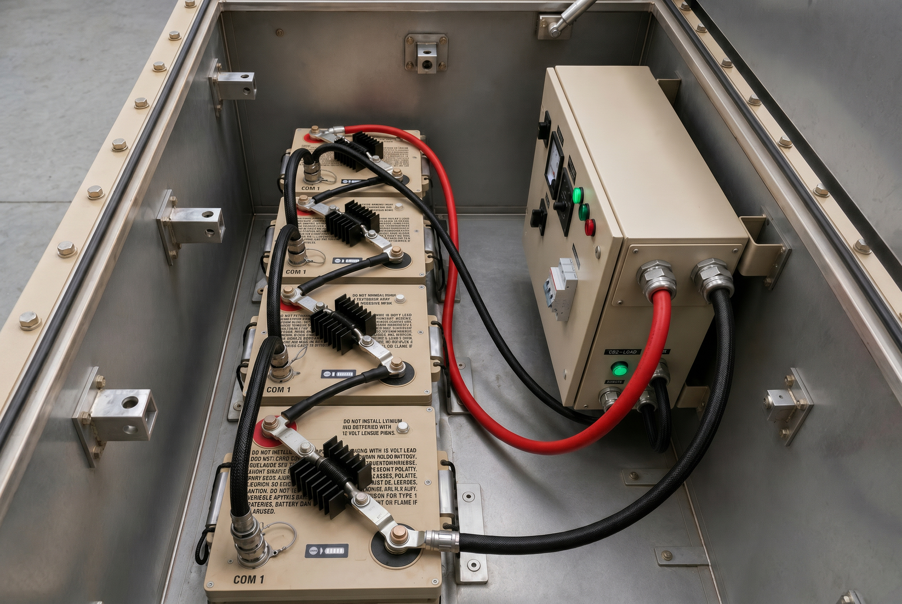
Thank You!
100V, 6T battery string

